Slide 1

Table of Contents
Intro
Modular Instrument Design
Some General Utilities
Uniform Code for Files on Different Computers
figure lists
Plotting All the data
nddata objects
PySpecData nddata objects
PySpecData nddata objects
PySpecData nddata objects
Standard numpy arrays (ndarray objects)
PySpecData nddata objects
Automatic Propagation of Error
Automatic Relabeling of axes
“Smart” Determination of Dimensionality
Aliasing + Axis Registration
Methods
Methods
Methods
Methods
Some examples
Phasing Echo-like data
Fitting T₁ data
Some noisy RM data
Determining the transfer function from the pulse reflection

Slide 2
Intro

Slide 3
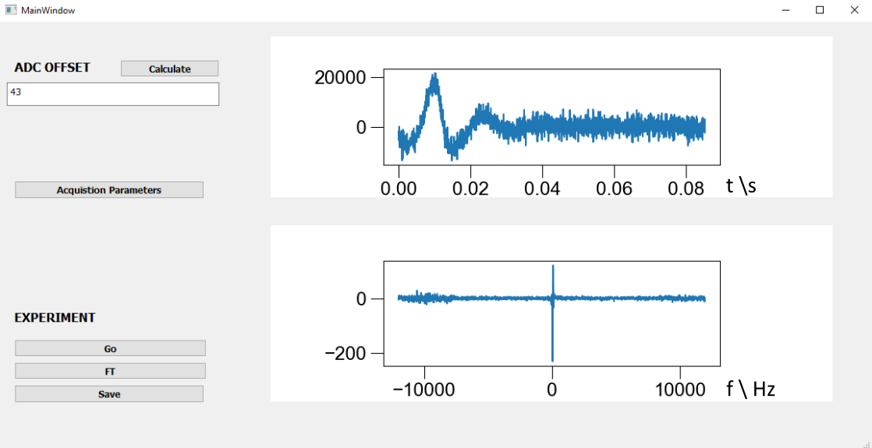
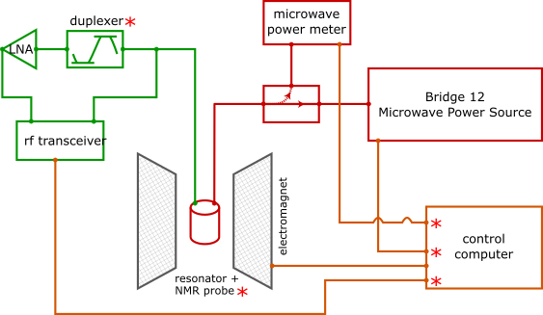
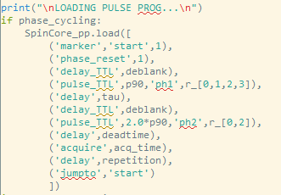
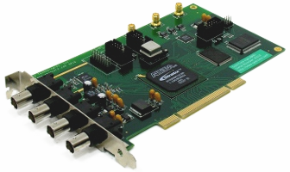
Modular Instrument Design

Slide 4
pySpecData → our library (starting in Songi’s lab, carried to Freed lab, continuing with it at Syracuse) → http://github.com/jmfrancklab/pyspecdata

Slide 5
Some General Utilities

Slide 6
Uniform Code for Files on Different Computers
Designed for integration with different computers:
d = find_file('200212_IR_3_30dBm', exp_type='test_equip')
(I have configured a data directory on my computer, and there is a subdirectory called test_equip that lives inside this → look for a file named 200212_IR_3_30dBm inside that subdirectory).
Automatic filetype recognition.
If file is missing, generates a message on how to download the data:
Traceback (most recent call last): File "fitdata_test.py", line 82, in <module> directory = getDATADIR(exp_type = 'test_equip' )) File "c:\users\johnf\notebook\pyspecdata\pyspecdata\core.py", line 6629, in __init__ check_only=True, directory=directory) File "c:\users\johnf\notebook\pyspecdata\pyspecdata\core.py", line 1042, in h5nodebypath +errmsg) AttributeError: You're checking for a node in a file (200212_IR_3_30dBm.h5) that does not exist I can't find 200212_IR_3_30dBm.h5 in C:\Users\johnf\exp_data\test_equip\, so I'm going to search for t in your rclone remotes checking remote g_syr: You should be able to retrieve this file with: rclone copy -v --include '200212_IR_3_30dBm.h5' g_syr:exp_data/test_equip C:\\Users\\johnf\\exp_data\\test_equip

Slide 7
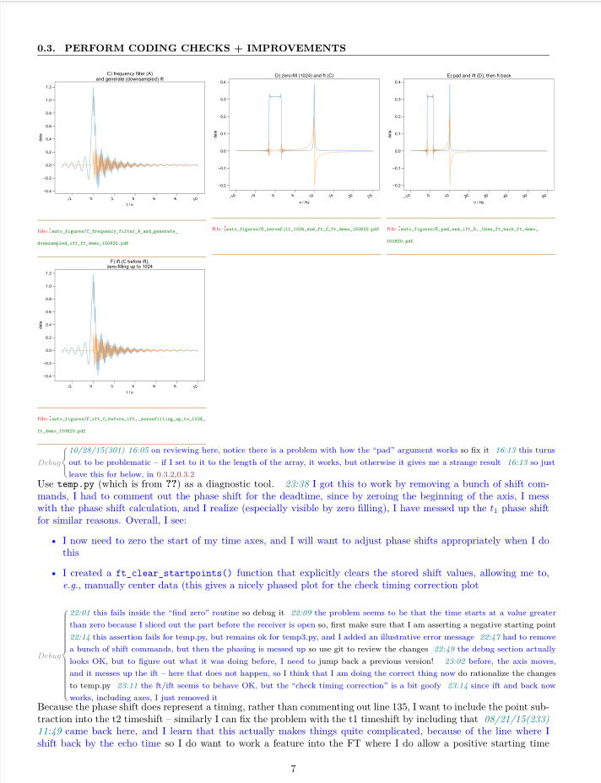
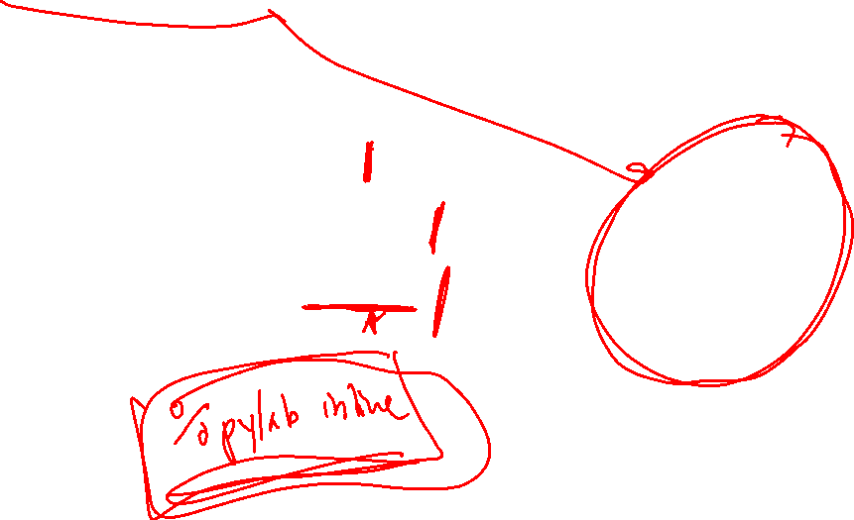
figure lists
Add figures (and text) to a figure list:
keep track of units of different datasets added to the figure
assign names (usually matching titles) to the plots
use the same code to generate pop-up windows, or drop it into a PDF (latex) lab notebook

Slide 8
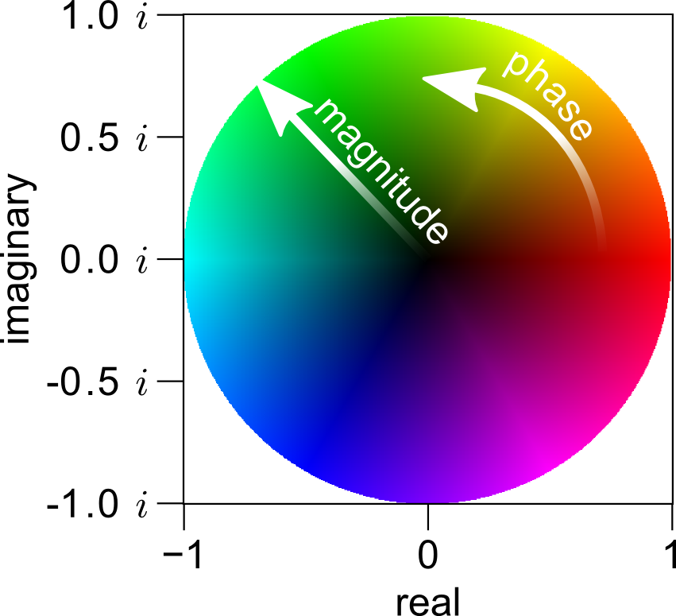
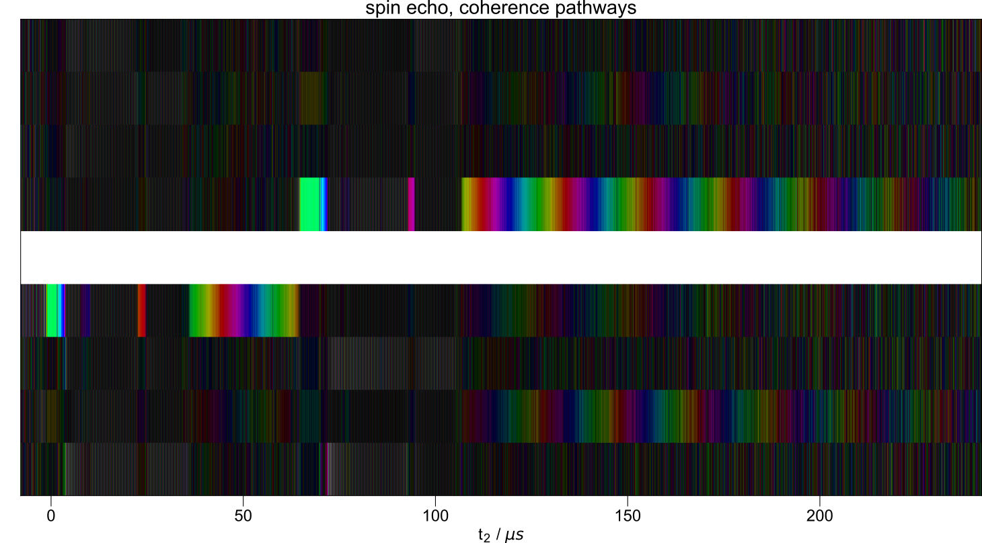
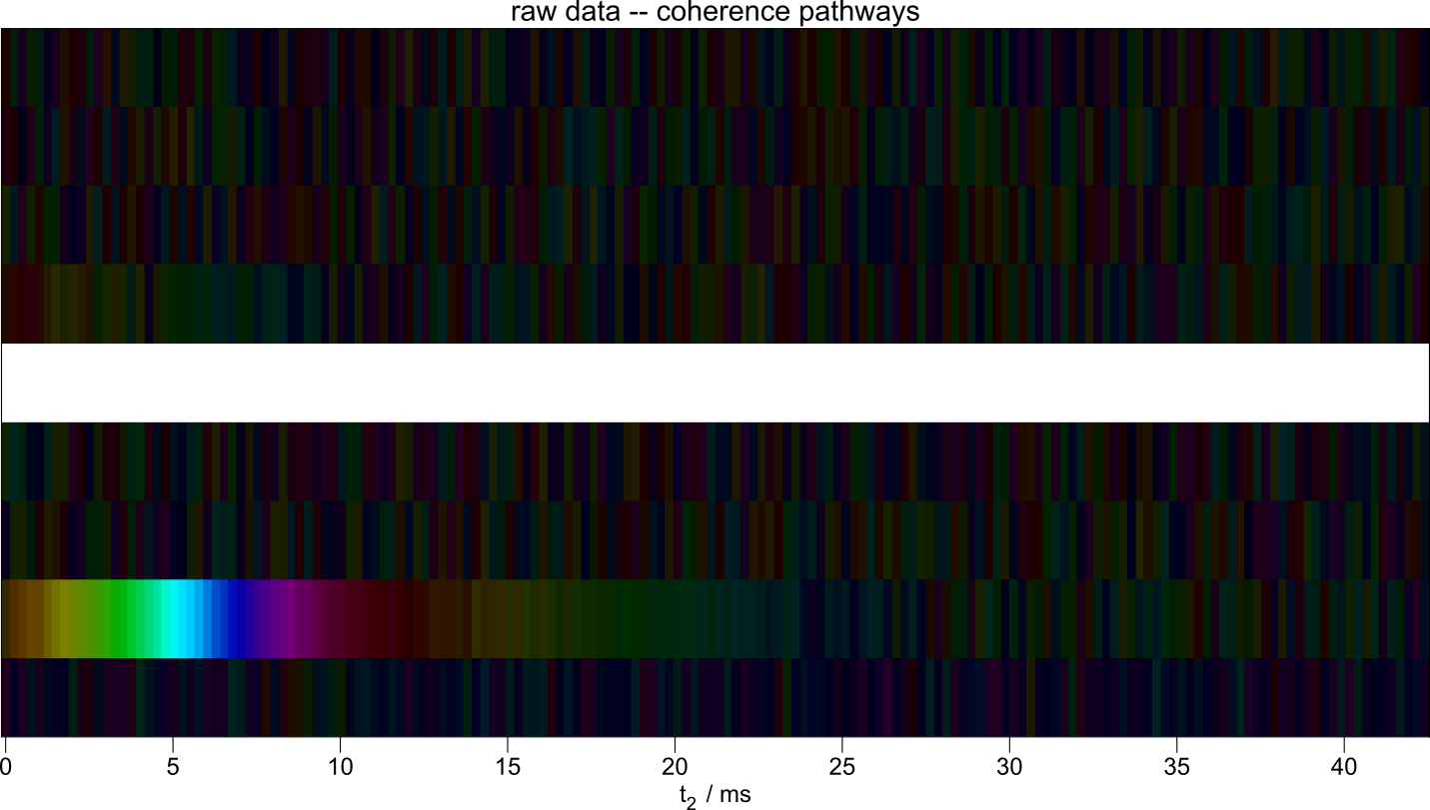
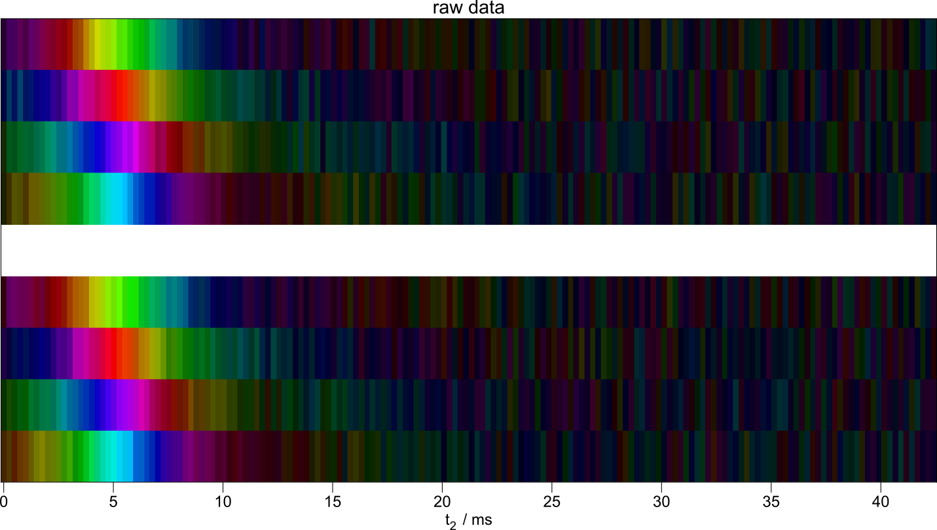
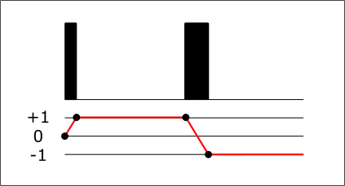
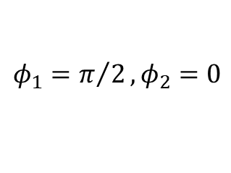
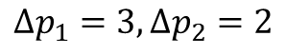
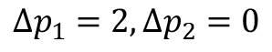
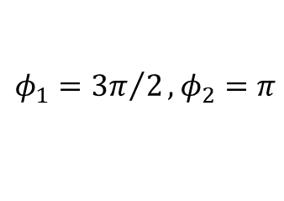
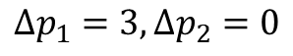
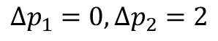
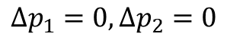
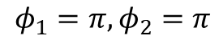
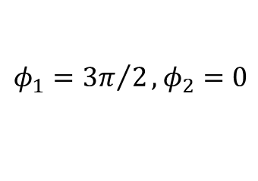
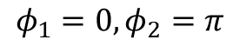
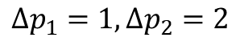
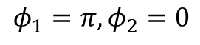
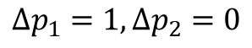
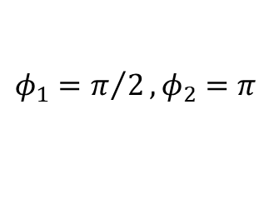
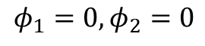
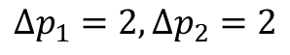
Plotting all the data
$$φ_{1}={3π}/2, φ_{2}=π$$
Pulse + deadtime
Pulse + deadtime
$$Δp_{1}=3, Δp_{2}=2$$
$$φ_{1}=π, φ_{2}=π$$
$$Δp_{1}=2, Δp_{2}=2$$
$$Δp_{1}=1, Δp_{2}=2$$
$$φ_{1}=π/2, φ_{2}=π$$
$$Δp_{1}=0, Δp_{2}=2$$
$$φ_{1}=0, φ_{2}=π$$
$$φ_{1}={3π}/2, φ_{2}=0$$
$$Δp_{1}=3, Δp_{2}=0$$
$$φ_{1}=π, φ_{2}=0$$
$$Δp_{1}=2, Δp_{2}=0$$
$$φ_{1}=π/2, φ_{2}=0$$
$$Δp_{1}=1, Δp_{2}=0$$
$$φ_{1}=0, φ_{2}=0$$
$$Δp_{1}=0, Δp_{2}=0$$
1. Bodenhausen, G. et al. Journal of Magnetic Resonance (1969) 1984, 58 (3), 370–388.

Slide 9
nddata objects

Slide 10
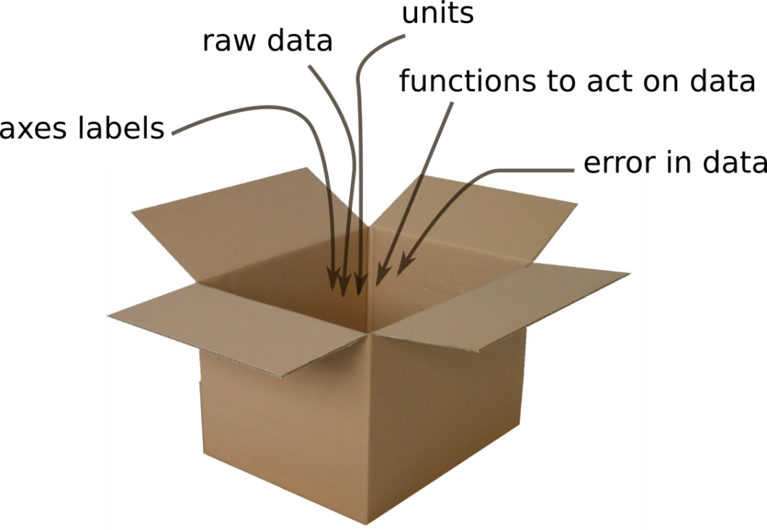
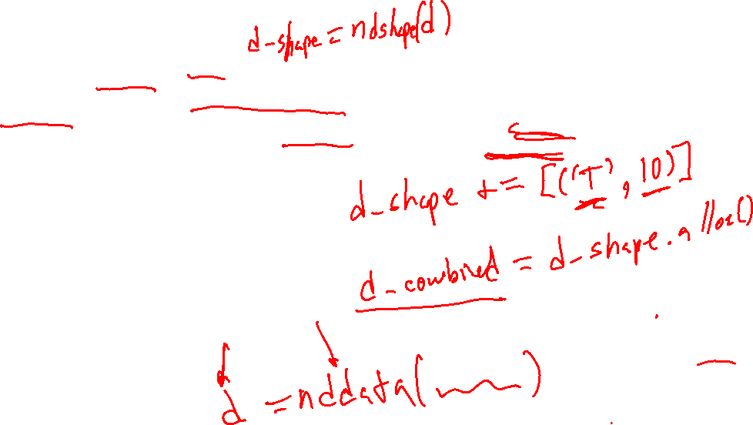
PySpecData nddata objects
Store all the information we might want for a plot (and more) in one “container” (object) → call our container nddata.

Slide 11
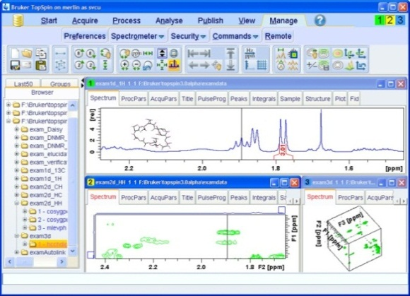
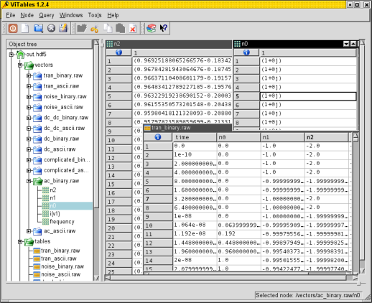

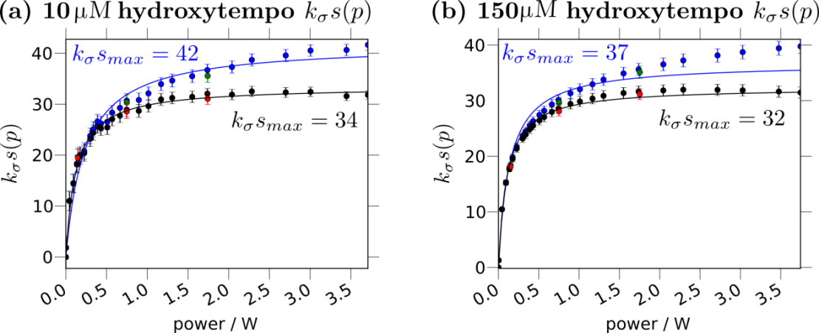
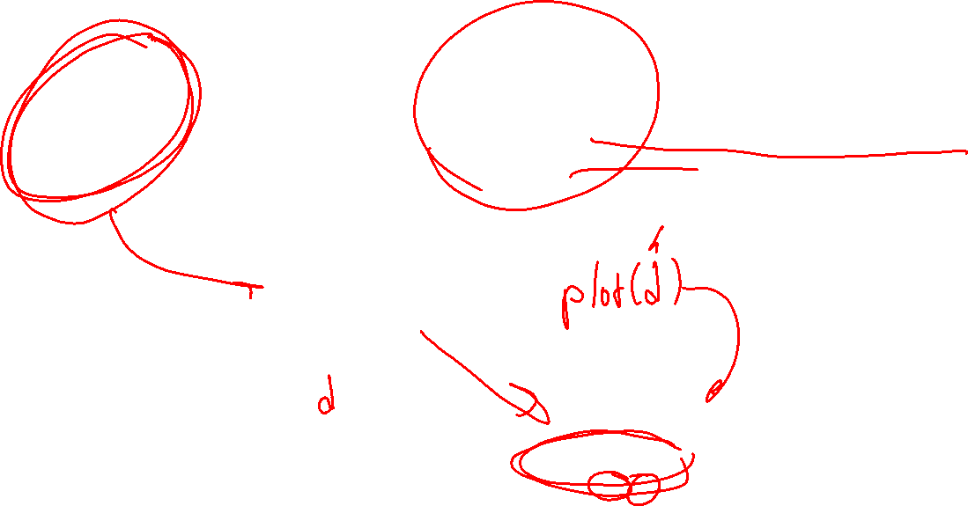
PySpecData nddata objects
Provides an opportunity to structure the data.
database
proprietary data formats
“Nd-data”
plots

Slide 12
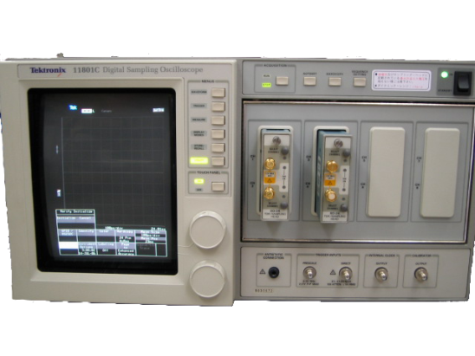
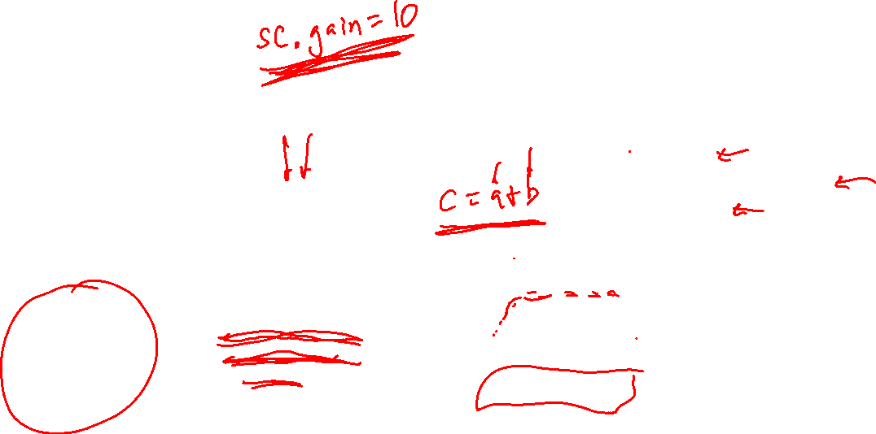
PySpecData nddata objects
Also → facilitate manipulation and acquisition of data
Technically:
Methods
Operator overloading
Properties
database
proprietary data formats
“Nd-data”
plots
Fourier transform,
error propagation,
curve fit, etc.
instruments

Slide 13
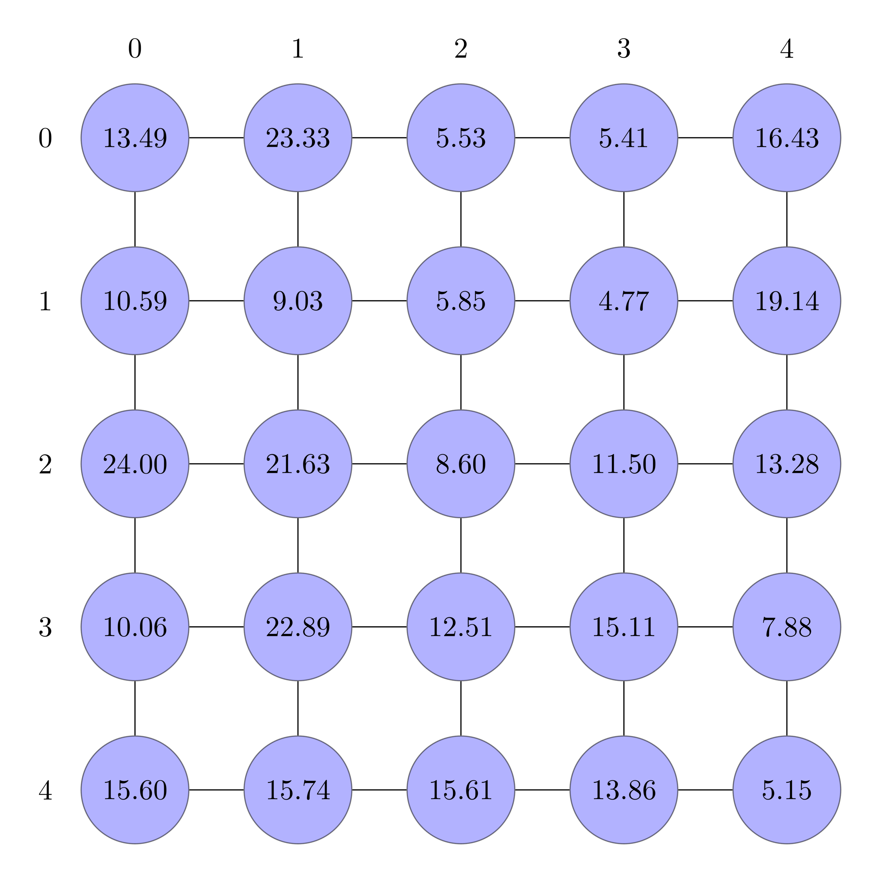

Standard numpy arrays (ndarray objects)
Say this is called d, then
d_sliced = d[1:,1:4]
slices out relevant data – e.g. for:
frequency filtering
selecting portions of time axis that actually contain data
Notes:
one of the most fundamental operations that we do all the time involves slicing and indexing

Slide 14
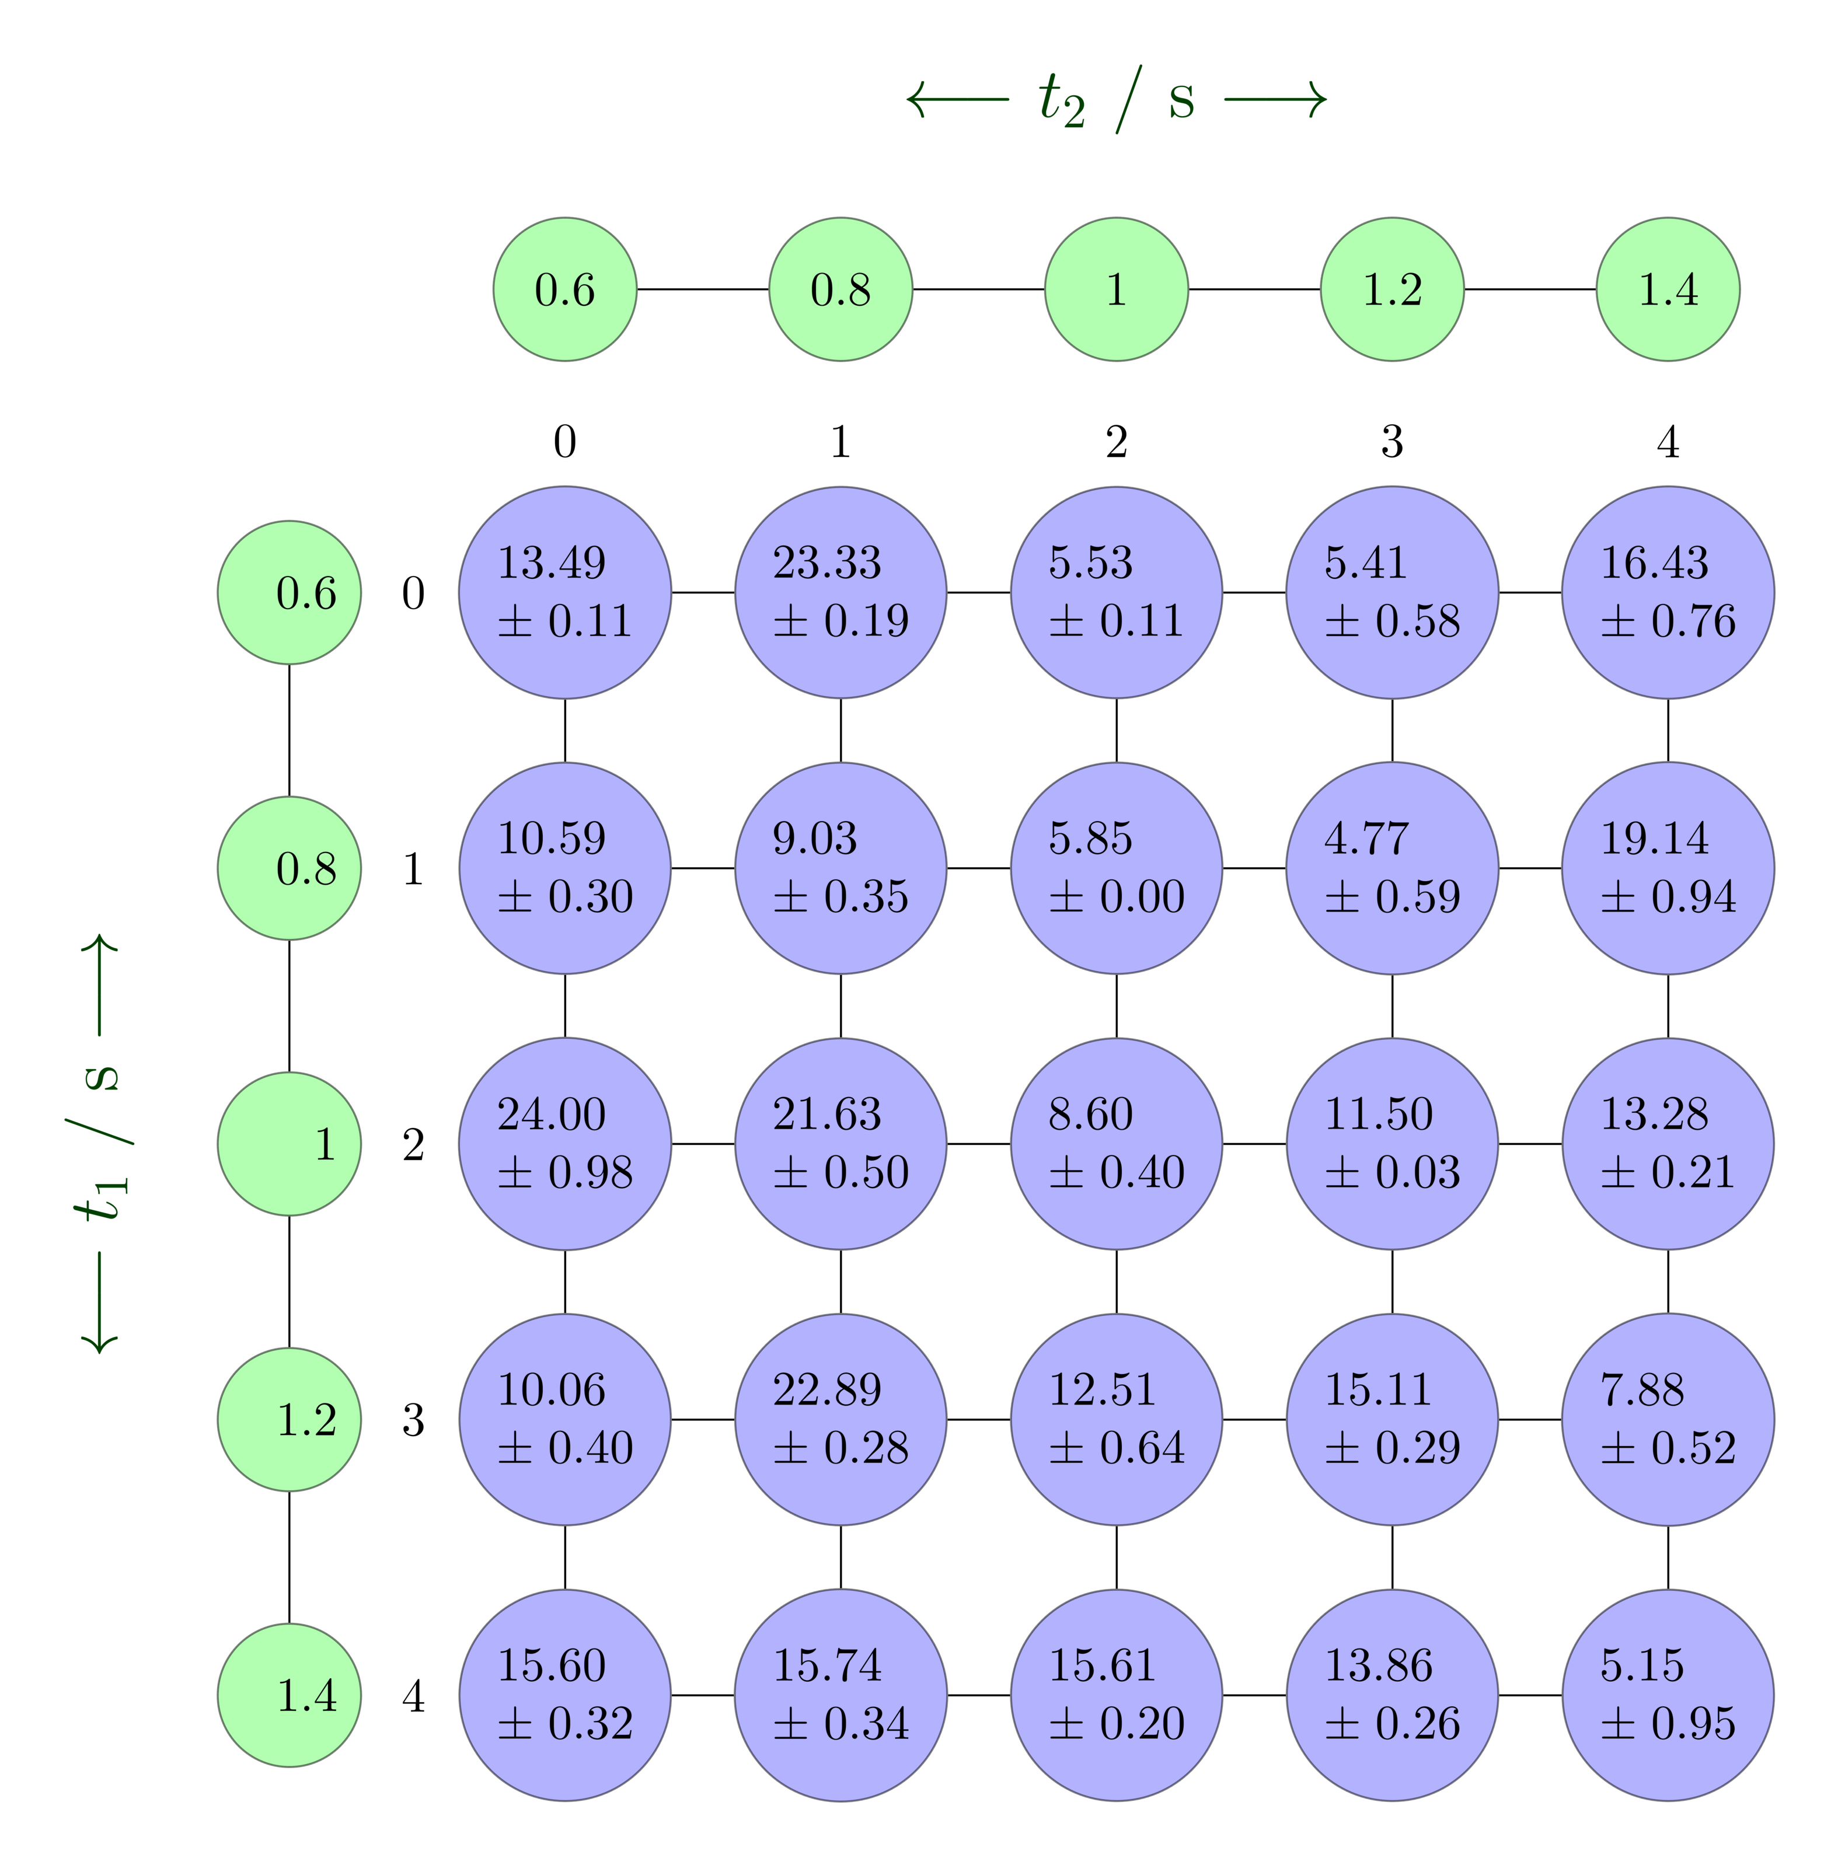


PySpecData nddata objects
Named axes help avoid confusion:
d_sliced = d['t1',1:4]['t2',1:]
We can slice by the frequency rather than the index number:
d_sliced = d['t1':(0.8,1.2)]['t2':(0.8,None)]

Slide 15
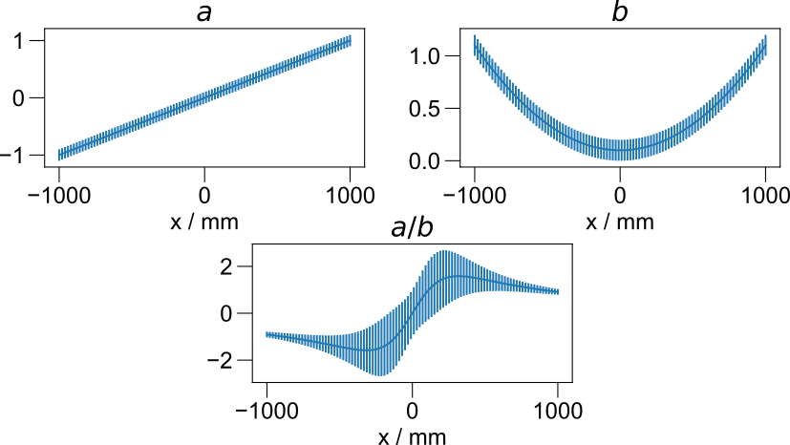

Automatic Propagation of Error
from pyspecdata import * fl = figlist_var() a = nddata(r_[-1:1:1j],'x').set_units('x','m') a.set_error(0.1) b = a.C b.run(lambda t: t**2+0.1) b.set_error(0.1) print(b.get_error('x')) fl.next('$a$', figsize=(4.5,2)) fl.plot(a) fl.next('$b$', figsize=(4.5,2)) fl.plot(b) fl.next('aob', figsize=(4.5,2)) fl.plot(a/b) title('$a/b$') fl.show()

Slide 16
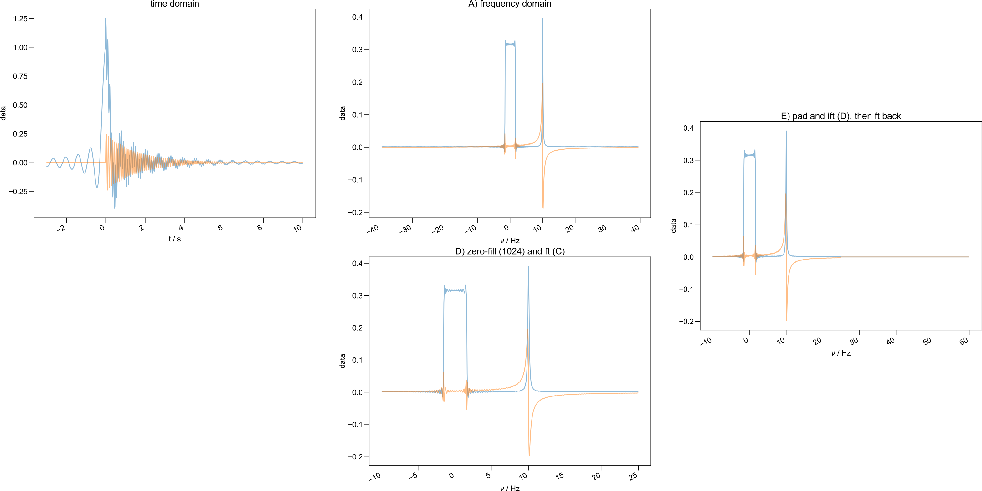
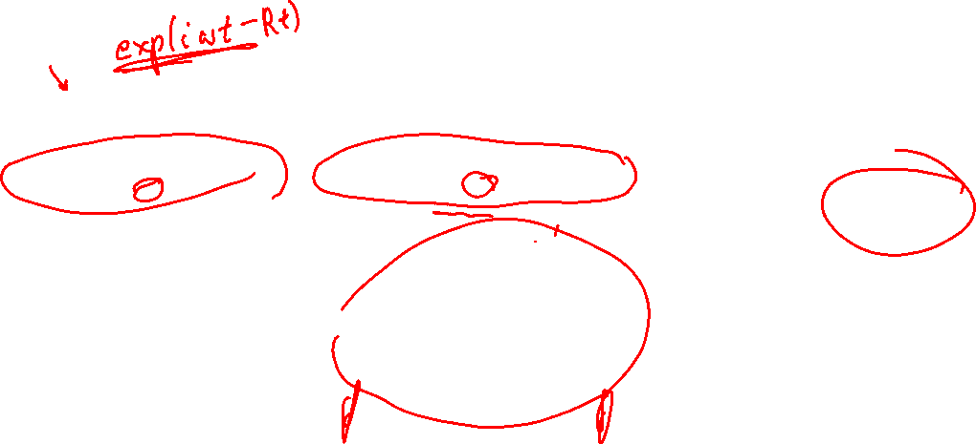
Automatic Relabeling of axes
d.ft(‘t', shift=True)

Slide 17
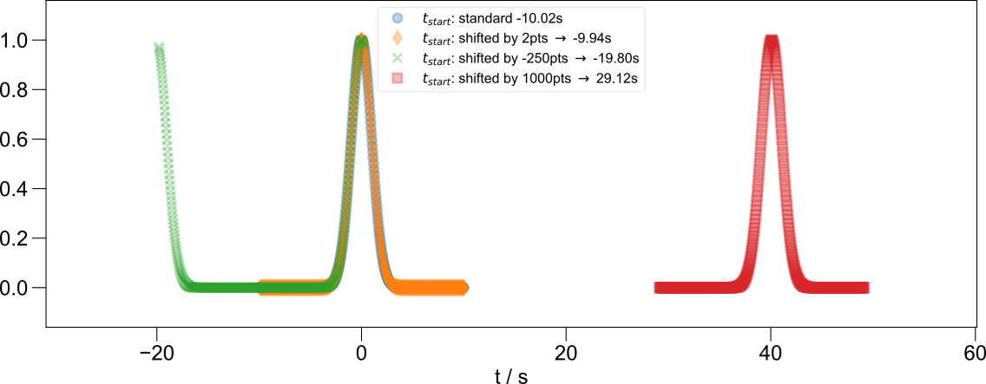
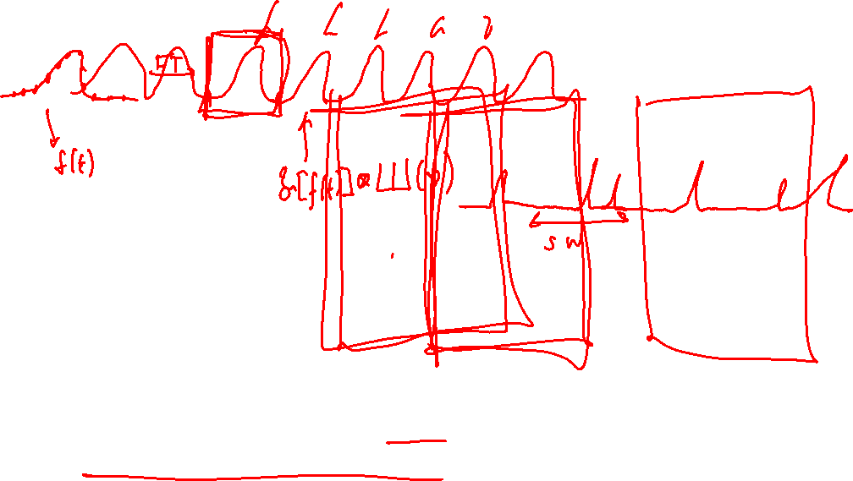
Aliasing + Axis Registration
Powerful tools, such as looking at different “aliases”:
forplot.ft_clear_startpoints('t', t=new_startpoint, f='current')
More specifically, we can relabel our axes and interpolate onto a new axis:
s.setaxis('t2',lambda x: x-peak_center) s.register_axis({'t2':0})
(first-order phase shift, but actually reflected in the data)

Slide 18
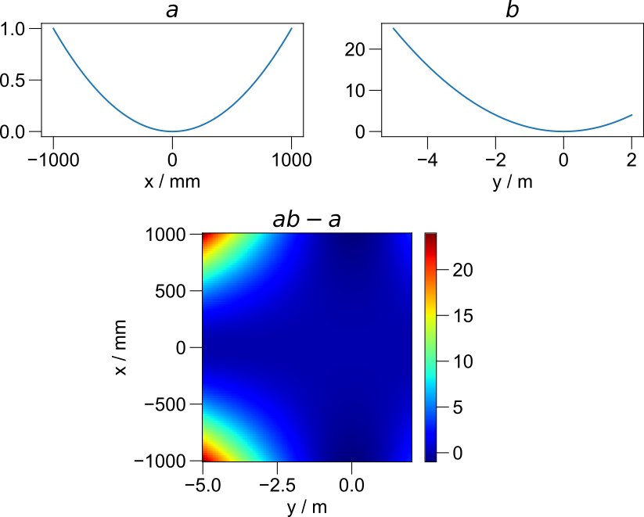

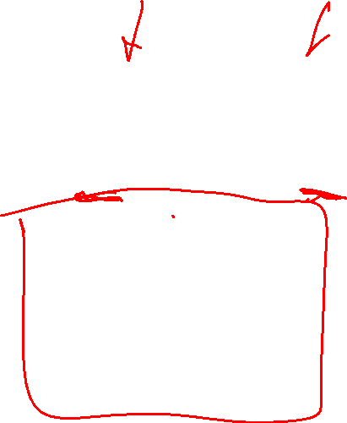
“Smart” Determination of Dimensionality
from pyspecdata import * fl = figlist_var() a = nddata(r_[-1:1:100j],'x').set_units('x','m') a.run(lambda t: t**2) b = nddata(r_[-5:2:200j],'y').set_units('y','m') b.run(lambda t: t**2) fl.next('$a$', figsize=(4.5,2)) fl.plot(a) fl.next('$b$', figsize=(4.5,2)) fl.plot(b) fl.next('$ab-a$', figsize=(4.5,4)) fl.image(a*b-a) fl.show()

Slide 19
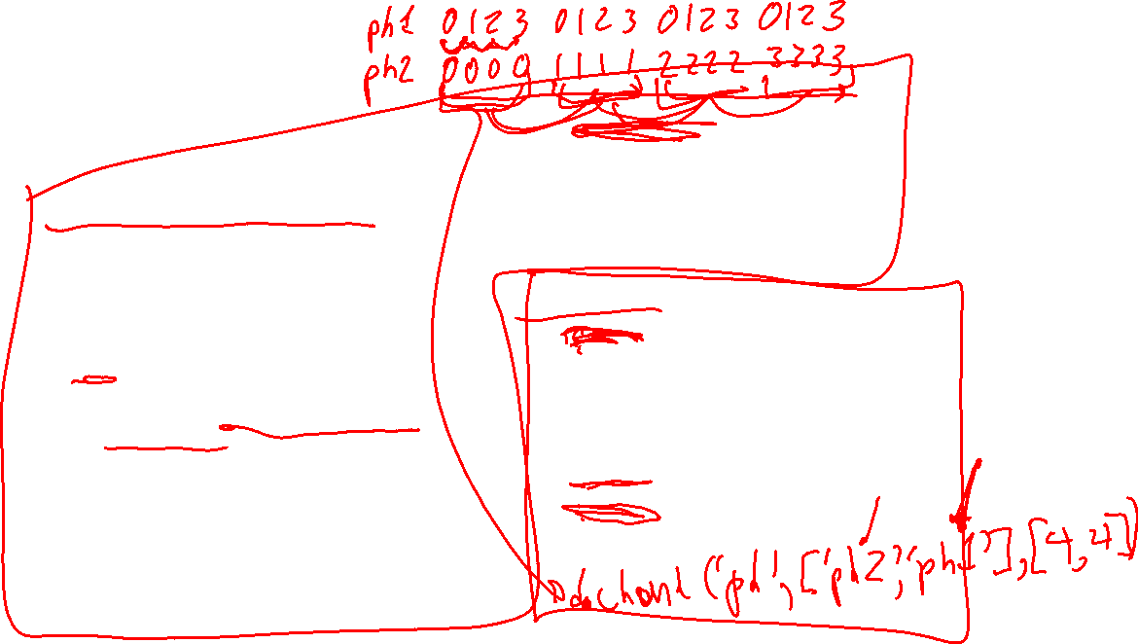

Methods
These are all methods → they appear to be inside the data, e.g.:
d = d.copy()
Manipulating attributes of the data:
copy
copy_props → copy the “other info”
get_units → units of axis
replicate_units
set_units
setaxis → manipulate the axis
can take a function as an argument
s.setaxis('t2',lambda x: x-peak_center)
set_prop → properties in a generic “other info” dictionary
copyaxes
get_error
get_plot_color
get_prop → opposite of “set_prop”
hdf5_write
like → “ones-like”
labels → set multiple axis labels w/ a dictionary
name → (of the data) used for HDF5 + plotting
set_error
Reshaping:
chunk → split dimension
chunk_auto → split dimension based on record array
item → single element to float or int
rename → dimension label
reorder
smoosh → opposite of “chunk”
squeeze → remove dimensions of size 1
extend → zero padding
Notes:
Chunk and smoosh → example of CPMG

Slide 20
Methods
Utility Functions (benefited by naming):
argmax, argmin → yields axis values (frequency/time)
contiguous → takes a logical function, yields axis values (e.g. peak picking)
dot
fromaxis → generate an nddata from an axis
integrate → uses x axis for numerical integration
interp,invinterp
polyfit
(overloaded): + - / exp and trig functions
error propagation
automatic reordering
General utilities:
add_noise → for simulation
cdf → cumulative dist. func.
circshift
cropped_log
mean, mean_all_but, mean_nopop, mean_weighted
run, run_nopop, runcopy → apply numpy functions in-place
sum, sum_nopop, diff
sort
to_ppm
Notes:
Manipulate data in-place rather than generating copies

Slide 21

Methods
Plotting:
contour
histogram
human_units
matrices_3d
mayavi_surf
meshplot
oldtimey
unitify_axis
plot_labels
waterfall
set_plot_color
Fourier:
convolve
fourier_shear
ft
ft_clear_startpoints
ftshift
get_ft_prop
ift
register_axis
set_ft_prop

Slide 22
Methods
More internal/development:
aligndata → match shapes
axn → (internal) number of named axis
fld → generate dict of info about axes
getaxis → ndarray for axis of a given dimension
mkd ~nddata.popdim ~nddata.set_to
More complicated manipulations:
extend_for_shear
inhomog_coords
linear_shear
nnls → ILT
secsy_transform
secsy_transform_manual
shear
Notes:
Highlight nnls

Slide 23
Some examples

Slide 24
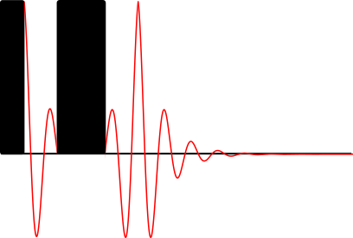
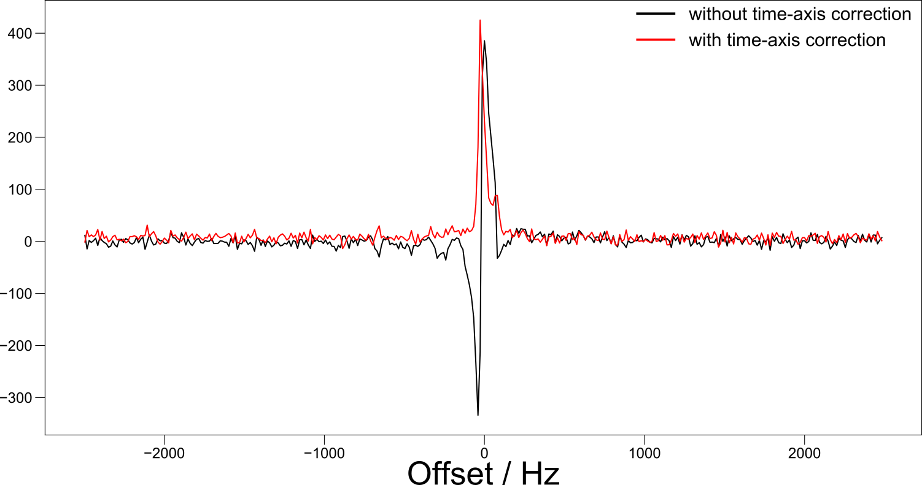
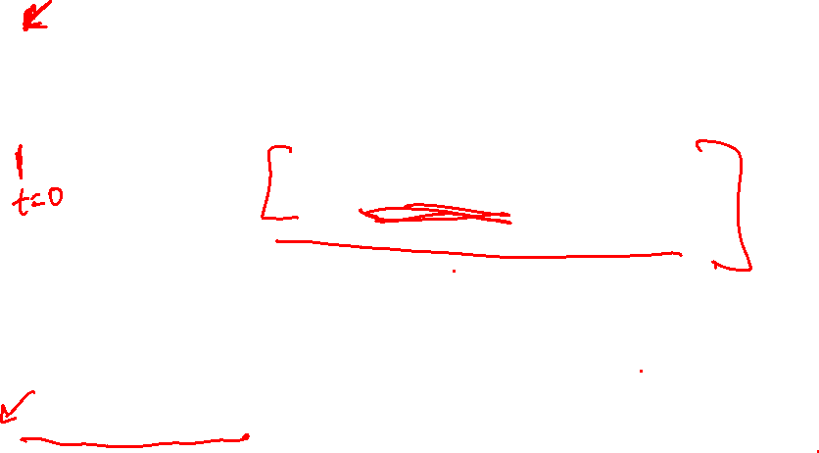
Phasing Echo-like data
accomplished with:
s.setaxis('t2',lambda x: x- peak_center) s.register_axis({'t2':0})

Slide 25
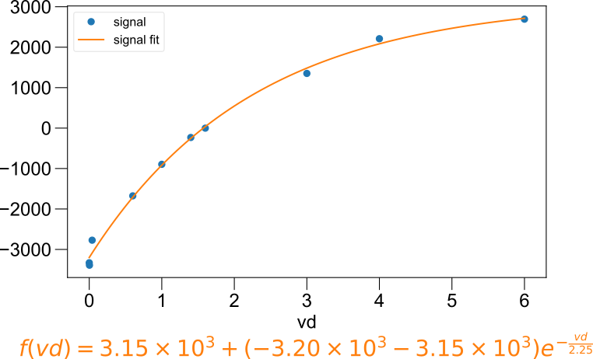
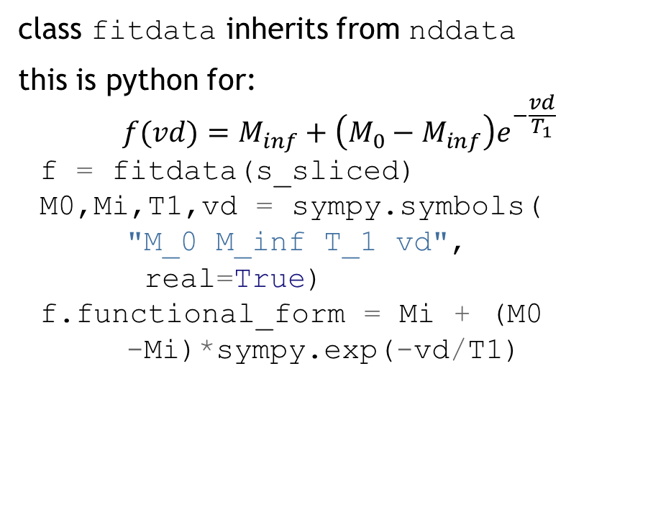

Fitting T₁ data
class fitdata inherits from nddata
this is python for:
$$f(vd)=M_{inf}+\left(M_{0}−M_{inf}\right)e^{−\frac{vd}{T_{1}}}$$
f = fitdata(s_sliced) M0,Mi,T1,vd = sympy.symbols(
"M_0 M_inf T_1 vd",
real=True) f.functional_form = Mi + (M0
-Mi)*sympy.exp(-vd/T1)

Slide 26



Determining the transfer function from the pulse reflection

Slide 27
Future Directions

Slide 28

Make axes into an object (see black text above)
Clean up fitdata (symbolic math)
Separate methods into categories
Object-oriented figure list

Slide 29
Figure list upgrades
Take advantage of “figure lists” while avoiding some of the disadvantages:
Build the new system around a list of visualization objects.
In the simplest example, a visualization object corresponds to e.g. a single matplotlib axis; but it can also correspond to multiple axes, as when we want to plot multi-dimensional data, or when we want to show the projections of 2D data.
By breaking the plotting process into several methods, we can automate the process, while also keeping it maximally flexible.
From the end-user’s perspective, plotting is achieved by
optionally modifying an existing plotting object class to get different properties than the default: the default classes available are image, plot, contour, and surface
creating instances of the plotting classes inside inside the figure list, in order of appearance (note that sometimes, it will make sense to first initialize blank plots, and drop data into them if the order of plotting and data generation are different)
adding nddata objects (or numpy objects, which are converted to nddata objects) to the plotting instances (quite literally)
with figlist_var('filename.pdf') as fl: pl_first = fl.next() pl_first += d_rough.real
if interactive plotting is employed, the nddata themselves are updated, and then the figurelist update method is called.

